Slide 1
Informatics - 312
Enterprise Risk Management

Slide 2
Third-Party Risk Management
“All organisations, no matter how small and uncomplicated, are impacted by third party/supply-chain, or “Nth-party” risk as it is also known”
Solarwinds
Akamai Technologies
Capital One/Amazon Web Services hack
Sita/Singapore Airlines
Notes:
Cook, Carrie. “Untangling the Supply Web: Managing Third-Party Risk.” Risk Business, September 8, 2021. https://riskbusiness.com/blog/untangling-the-supply-web-managing-third-party-and-supply-chain-risk/.
SolarWinds
The SolarWinds hack in 2020 was one of the biggest cyber hacks of the 21st century. It was a particularly significant event because SolarWinds supplies online system management tools for hundreds of thousands of companies around the globe.
What happened at SolarWinds?
Hackers gained access to the SolarWinds network and planted malicious code (now known as “Sunburst”) into its Orion network management system. More than 30,000 organisations were using SolarWinds’ Orion product to manage their networks at the time, including several US Government agencies. The hidden malicious code planted by hackers meant that when users were sent a routine Orion software update, they were unknowingly installing the malware into their own systems. More than 18,000 SolarWinds users are understood to have installed the malicious updates. This included large, global tech firms such as Microsoft and Intel and cyber security firms such as FireEye – which was the first company to detect the hack.
What data was compromised?
Hackers were able to gain access to sensitive data held by government agencies including, the US Treasury, the Pentagon, the Department of Homeland Security, the State Department, the Department of Energy and the National Nuclear Security Administration (NNSA).
It is unclear exactly how much data was compromised or the exact objectives of the attack. It is believed the breach may have begun as far back as September 2019 and was not detected until December 2020, giving the hackers free reign for over a year. The UK and US governments have both blamed the attack on Russia’s SVR (The Foreign Intelligence Service of the Russian Federation) agency. Increasing numbers of companies are discovering that they were victims of the attack – more than eight months after it was uncovered – including computer-aided design software manufacturer Autodesk, who recently reported it in their latest quarterly results. The true impact of the event is still unfolding and it will be some time before we know the full implications.
Akamai Technologies
Akamai, one of the world’s largest providers of content delivery networks, suffered an outage in July this year, impacting major banking websites including HSBC, Barclays, Lloyds, Sainsbury’s Bank, Tesco Bank and several gaming and retail sites. The outage lasted just over an hour and was caused by a configuration update which triggered a DNS (domain name system) bug.
The DNS is what links a website with its IP address. A DNS bug causes a glitch in this process, essentially preventing internet access for the affected website. Content delivery networks (one of the services provided by Akamai) are physical network servers which are geographically spread to optimise website performance by ensuring close proximity for end users. In basic terms, it is a network of servers spaced apart so that everyone who wants to access a website can do so.
Was the Akamai outage the result of a hack?
No. According to Akamai, the outage was caused by a software configuration update, rather than a cyber attack.
Capital One/Amazon Web Services hack
In July 2019, Capital One confirmed it had fallen victim to a data hack. An ex-Amazon employee, Paige Thompson, is accused of creating a software program to exploit a common glitch in the firewall of the web app used by Amazon Web Service (AWS) customers. More than 100 million Capital One customers were affected by the hack, plus a confirmed eight other companies using the service. It is understood that as many as 30 companies in total may actually have been targeted.
Thompson is believed to have downloaded the details from 106 million Capital One credit card applications, which included information such as social security numbers, bank account details, birth dates and addresses. It is still unclear what happened to the data after it was downloaded. Thompson is also accused of using AWS customers’ cloud computing abilities to set up cryptocurrency mining operations.
AWS were also back in the news at the beginning of September 2021 when a hardware device failed, leading to system outages for several banks, brokerages and airlines in Japan for almost an entire day.
Sita/Singapore Airlines
Sita supplies IT systems to the air transport industry and suffered a data breach earlier this year. The breach impacted several of its customers who used Sita’s passenger service system, which shares frequent flyer data with other airlines within the same airline alliance. Singapore Airlines was one of the firms affected by the breach. Though it was not a direct customer of Sita, it had shared data with another firm within the Star Alliance of airlines, which did use the service.
The above examples demonstrate how wide-reaching a supply chain incident can be. Capital One was fined US$80m by US regulators for failing to protect customer data – even though it was the AWS system that the hacker gained access through. In the Akamai example, cyber security wasn’t the issue, so due diligence checks in this area would not have prevented this event from happening. And the SolarWinds incident proves there are some third-party risks that we are completely oblivious to, causing untold damage and occurring as we speak.

Slide 3
Third-Party Risk Management
Refinitiv surveyed 1,800 businesses in February 2020 and found
60% of respondents were not fully monitoring third-party suppliers for on-going risks.
62% said they did not know how many third parties they engage are outsourcing work to others.
53% said they would report a third-party breach internally
only 16% would report it externally, demonstrating just how quickly the firm’s perspective on this type of risk can become murky
Notes:
Cook, Carrie. “Untangling the Supply Web: Managing Third-Party Risk.” Risk Business, September 8, 2021. https://riskbusiness.com/blog/untangling-the-supply-web-managing-third-party-and-supply-chain-risk/.

Slide 4
What Is Third-Party Risk Management?
Third-party risk management (TPRM) is the process of identifying and mitigating risks created when working with outside organizations.
TPRM is the proactive solution to risk control, which provides the framework, policies, and procedures you need to evaluate new and existing third-party partnerships.
Notes:
“Third-Party Risk Management: The Beginner’s Guide.” Accessed April 28, 2024. https://drata.com/blog/third-party-risk-management#heading-what-is-third-party-risk-management.
Third-party relationships are practically unavoidable. However, a more connected world creates IT security risks that could result in data loss or system outages. Growing reliance on third parties for business functions creates a financial risk should a third party’s actions disrupt your business operations. The actions of a third party can also create legal risks for your company.

Slide 5
Common Types of 3rd Party Risk
Cybersecurity risk
Operational risk
Compliance risk
Financial risk
Strategic risk
Reputational risk
Notes:
“Third-Party Risk Management: The Beginner’s Guide.” Accessed April 28, 2024. https://drata.com/blog/third-party-risk-management#heading-what-is-third-party-risk-management.
Cybersecurity risk: Data breaches caused by weak security systems and ineffective infrastructure can leak customer information and other sensitive data. Many cyber threats can be mitigated through cybersecurity risk management.
Operational risk: Employee or partner error, fraud, criminal activity, and other events can interrupt business operations. Broken systems, confusing processes, and informal policies between an organization and its third parties can be the catalyst.
Compliance risk: Leaked information and insecure systems can affect regulatory compliance. Non-compliance, including HIPAA violations, can lead to hefty fines and jail time in serious cases.
Financial risk: Supply and operation disruptions, including the inability to sell products, caused by third parties can negatively impact an organization's bottom line.
Strategic risk: Third-party relationship termination or disruption will affect operations, which can halt progress toward organizational goals. Failure to meet internal objectives can impact strategies, which puts project completion at risk.
Reputational risk: Data breaches caused by weak third-party security can exponentially affect organizational reputations and impact customer perception of your company—even if your organization didn't cause the breach.

Slide 6
3rd Party - 3rd Party Risk = 4th Party Risk
Third-party partners are suppliers or vendors you do direct business with and have formal contracts.
Fourth parties are not contractually related to your business. Instead, they are the third-party vendors of your third-party vendors.
When designing TPRM and vendor risk management plans, you must consider how you will handle relationships with fourth parties
Notes:
“Third-Party Risk Management: The Beginner’s Guide.” Accessed April 28, 2024. https://drata.com/blog/third-party-risk-management#heading-what-is-third-party-risk-management.
Third-party partners are suppliers or vendors you do direct business with. These parties should be under a formal contract with your business. Fourth parties are not contractually related to your business. Instead, they are the third-party vendors of your third-party vendors.
When designing TPRM and vendor risk management plans, you must consider how you will handle relationships with fourth parties. Any third party with contracted relationships outside your own will pose different risks to your organization. Consider implementing fourth-party risk management strategies into your formal plans:
Request timely updates to fourth-party changes—additions, subtractions, or adjustments.
Consider creating formal documentation for fourth-party partners that requires your prior approval to changes impacting your business operations or customer data.
Read and review your third party’s due diligence, oversight, and partnership protocols.
Fourth-party relationships may increase risk, but they can also be vital to your business operations. This makes it critical to understand how your third-parties are managing their vendors and partners.

Slide 7
4th Party Risk Management Strategies
Request timely updates to fourth-party changes—additions, subtractions, or adjustments.
Create formal documentation for fourth-party partners.
Read and review your third party’s due diligence, oversight, and partnership protocols.
Notes:
“Third-Party Risk Management: The Beginner’s Guide.” Accessed April 28, 2024. https://drata.com/blog/third-party-risk-management#heading-what-is-third-party-risk-management.
Third-party partners are suppliers or vendors you do direct business with. These parties should be under a formal contract with your business. Fourth parties are not contractually related to your business. Instead, they are the third-party vendors of your third-party vendors.
When designing TPRM and vendor risk management plans, you must consider how you will handle relationships with fourth parties. Any third party with contracted relationships outside your own will pose different risks to your organization. Consider implementing fourth-party risk management strategies into your formal plans:
Request timely updates to fourth-party changes—additions, subtractions, or adjustments.
Consider creating formal documentation for fourth-party partners that requires your prior approval to changes impacting your business operations or customer data.
Read and review your third party’s due diligence, oversight, and partnership protocols.
Fourth-party relationships may increase risk, but they can also be vital to your business operations. This makes it critical to understand how your third-parties are managing their vendors and partners.

Slide 8
TPRM and Regulatory Compliance
HIPAA
GDPR
SOC 2
ISO 27001
FedRAMP
Notes:
“Third-Party Risk Management: The Beginner’s Guide.” Accessed April 28, 2024. https://drata.com/blog/third-party-risk-management#heading-what-is-third-party-risk-management.
HIPAA
U.S. healthcare organizations are subject to the Health Insurance Portability and Accountability Act (HIPAA), which established protections for patients’ protected health information (PHI)—inside and outside hospital walls.
Any business associates with access to patient information must be HIPAA-compliant. This includes independent laboratories, medical records processors, and other third parties. Healthcare organizations must diligently and regularly apply risk analysis and management processes to their internal systems and third-party relationships.
GDPR
The European Union’s General Data Protection Regulation (GDPR) applies broadly. Any company that collects and processes personal information must consider the risks this data processing creates for EU citizens.
Controllers are organizations that decide what personal information to collect and how to process it. These controllers may outsource processing to third-party processors, which may contract with a fourth-party sub-processor. GDPR expects a risk assessment to include risks created by their processors and sub-processors. This assessment should guide the development of appropriate technical and organizational security measures.
SOC 2
Companies use this compliance framework to create custom processes following a set of Trust Services Categories (TSC) instead of defined controls.
Organizations can use SOC 2 reports as part of their vendor selection process. These reports provide information about the effectiveness of a service provider’s controls and whether they align with the organization’s risk tolerance and security requirements. By choosing vendors with favorable SOC 2 reports, organizations can mitigate potential risks associated with outsourcing services to a third party that does not have the same level of controls in place.
ISO 27001
Companies with Information Security Management Systems (ISMS) use ISO 27001, an international standard of best practices. Correct implementation protects information security and implements internal risk management solutions.
ISO 27001 emphasizes a risk-based approach to information security. Organizations are required to identify potential security risks and vulnerabilities, assess their potential impacts, and implement appropriate controls to mitigate these risks.
FedRAMP
The federal government adheres to the Federal Risk and Authorization Management Program (FedRAMP), which is a compliance program created to ensure the security and privacy of federal information and systems when adopting cloud technologies.
Under the National Defense Authorization Act, FedRAMP provides federal agencies with a structured approach to assess, authorize, and monitor the security of third-party cloud providers. FedRAMP requirements also help federal agencies manage the risks associated with using external cloud services while benefiting from the security controls and practices implemented by authorized providers.

Slide 9
The TPRM Process
Review and revise existing risk policies.
Keep third-party exposure in mind. Be sure to consider how third parties can impact regulatory and other compliance requirements.
Conduct an audit of third-party relationships.
Extend this review beyond your formal purchasing contracts. Consider open-source dependencies, workgroup-level relationships, and shadow IT. Understand the risks created by these relationships.
Draft internal and external TPRM policies.
Supplement these policies with compliance expectations for specific business units.
Notes:
“Third-Party Risk Management: The Beginner’s Guide.” Accessed April 28, 2024. https://drata.com/blog/third-party-risk-management#heading-what-is-third-party-risk-management.
Review and revise existing risk policies. Keep third-party exposure in mind. Be sure to consider how third parties can impact regulatory and other compliance requirements.
Conduct an audit of third-party relationships. Extend this review beyond your formal purchasing contracts. Consider open-source dependencies, workgroup-level relationships, and shadow IT. Understand the risks created by these relationships.
Draft internal and external TPRM policies. Supplement these policies with compliance expectations for specific business units.

Slide 10
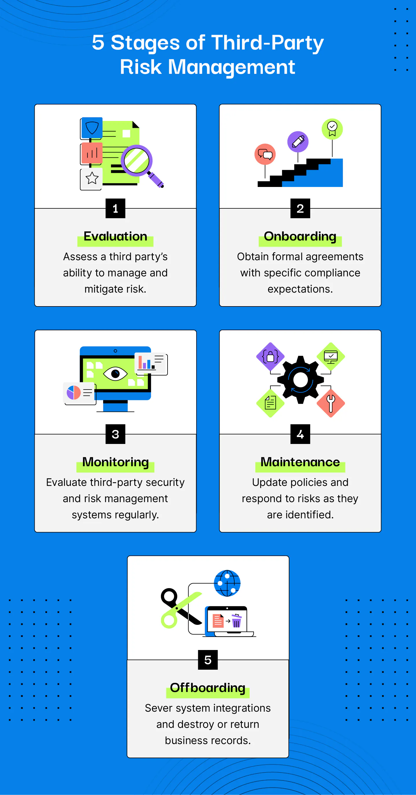
The TPRM Lifecycle
Evaluation and Risk Assessment
Onboarding
Monitoring
Maintenance
Offboarding and Termination
Notes:
“Third-Party Risk Management: The Beginner’s Guide.” Accessed April 28, 2024. https://drata.com/blog/third-party-risk-management#heading-what-is-third-party-risk-management.
Evaluation and Risk Assessment
Risk evaluation becomes part of the due diligence process whenever you consider a new third-party relationship. Whether you are evaluating a new or existing third-party partnership, you will use various techniques to assess the new company’s ability to manage risk. Any issues should be evaluated before bringing the new third party on board.
2. Onboarding
Third parties must adhere to specific onboarding procedures and sign contracts that specify compliance expectations. Be cautious of potential partners that are wary of formal contracting processes, and avoid entering into a partnership with a third party that will have access to your sensitive data without obtaining a signed contract.
3. Monitoring
Periodically re-evaluating third parties confirms the state of their security and risk management processes. Annual reviews may be sufficient for low-risk third parties. Those with access to critical systems and information, however, may require more frequent risk evaluations.
However, TPRM should be a continuous process. Pre-agreement evaluations may not capture every risk a relationship could create, and third-party organizational changes or relationship evolutions could introduce new risks before your next scheduled review. Consider investing in automated monitoring systems, which can flag emerging risks. With early notice, you and the third party have a chance to remediate the risk before it becomes a significant event.
4. Maintenance
Even with powerful monitoring systems, many compliance leaders agree most risks are only uncovered after bringing third parties on board. Maintenance procedures need to follow scheduled and unscheduled reviews. Update policies and respond to risks as soon as they are identified.
5. Offboarding and Termination
Business relationships inevitably end. When they do, you need processes to ensure risk does not linger after contract termination. Handing over the keys—digital and physical—is an obvious step. Offboard partners by securely severing system integrations and removing third-party users from access control systems. Remember to update access codes and collect ID cards.

Slide 11
Evaluating 3rd Parties
Risk assessment: Risk assessments and self-reported security questionnaires can help organizations identify how a potential vendor manages its own risks.
Penetration testing: Automatic and manual penetration testing can identify internal network and system security risks.
Evaluations: Onsite evaluations can provide objective assessments of a third party’s security and risk management processes.
Notes:
“Third-Party Risk Management: The Beginner’s Guide.” Accessed April 28, 2024. https://drata.com/blog/third-party-risk-management#heading-what-is-third-party-risk-management.
Bringing your existing third-party relationships into compliance with your TPRM policies requires a case-by-case evaluation and remediation plan. Every outside relationship needs to be considered—high-risk relationships should be examined more carefully than companies that pose a lesser risk.
Evaluate your third-party relationships using these tools:
Risk assessment: Risk assessments and self-reported security questionnaires can help organizations identify how a potential vendor manages its own risks.
Penetration testing: Automatic and manual penetration testing can identify internal network and system security risks.
Evaluations: Onsite evaluations can provide objective assessments of a third party’s security and risk management processes.
Based on this due diligence, you can define the remediation steps needed to bring each outside relationship into compliance. These steps could be the third party’s responsibility, or they may involve refinements within your TPRM process. Update your third-party contracts with service-level agreements that specify how each company must maintain compliance.

Slide 12
TPRM Frameworks

Slide 13
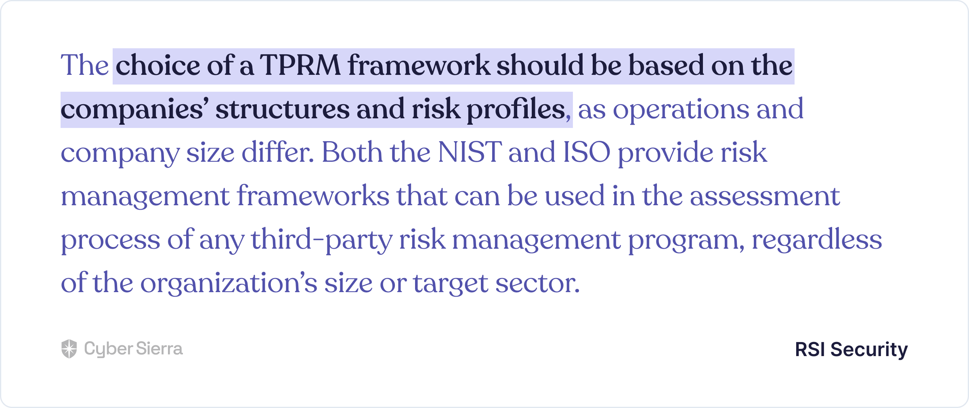
Enterprise TPRM Frameworks
Notes:
“TPRM Frameworks - How to Choose & Implement For Your Enterprise Business,” October 11, 2023. https://cybersierra.co/blog/enterprise-tprm-frameworks/.

Slide 14
Enterprise TPRM Frameworks
NIST Supply Chain Risk Management Framework (SCRMF) 800-161
NIST Vendor Risk Management Framework (RMF) 800-37
NIST Cybersecurity Framework (CSF)
ISO 27001, 27002, and 27018
ISO 27036
Notes:
“TPRM Frameworks - How to Choose & Implement For Your Enterprise Business,” October 11, 2023. https://cybersierra.co/blog/enterprise-tprm-frameworks/.
1. NIST Supply Chain Risk Management Framework (SCRMF) 800-161
NIST 800-161 was developed to supplement the NIST 800-53 designed specifically to help federal entities manage supply chain risks.
However, given the large number of 3rd parties enterprise organizations now work with, private sector organizations can also adopt NIST 800-161. This framework breaks down the supply chain or vendor risk management process into four phases:
Frame,
Access,
Respond, and
Monitor: Across these phases, there are 19 data security control themes, ranging from employee training to systems and service acquisition.
2. NIST Vendor Risk Management Framework (RMF) 800-37
Originally developed in 2005, the National Institute of Standards and Technology (NIST) revised this framework in 2018.
Generally, the NIST 800-37 RMF outlines steps companies can take to protect their data and systems. This includes assessing the security of systems, analyzing threats, and implementing data security controls. For vendor risk management purposes, section 2.8 of the framework specifically fits the bill. It is invaluable as it helps security teams consider relevant risk mitigation tactics for onboarding new third-parties.
3. NIST Cybersecurity Framework (CSF)
Considered the gold standard for building robust data security programs, the NIST Cybersecurity Framework can also be used when designing third-party risk management processes. Specifically, this framework outlines the best practices for creating vendor risk assessment questionnaires.
Base your third-party risk assessment questionnaires on security controls in the NIST CSF framework, and your team can accurately assess potential vendors’ cyber threat profiles. This is especially useful for enterprise organizations with strict privacy or regulatory compliance concerns.
4. ISO 27001, 27002, and 27018
The International Organization for Standardization (ISO) developed the ISO 27001, 27002, and 27018 standards. Although known more for implementing governance, risk, and compliance (GRC) programs, these standards can also be used in creating frameworks for evaluating third-party risks.
Specifically, each of these standards have sections guiding security teams to ensure their vendor risk assessments are thorough. This is in addition to each standard helping your team manage a broader information security program across your organization.
5. ISO 27036
Unlike other ISO standards focused more on companies’ overall GRC programs, ISO 27036 series helps organizations manage risks arising from the acquisition of goods and services from suppliers.
ISO 27036 has provisions for addressing physical risks arising from working with professionals such as cleaners, security guards, delivery services, etc. It also has more standard processes for working with cloud service providers, data domiciles, and others.

Slide 15
Adopting TPRM Frameworks
Risk Assessment
Due Diligence
Contractual Agreements
Incidence Response
Continuous Monitoring
Notes:
“TPRM Frameworks - How to Choose & Implement For Your Enterprise Business,” October 11, 2023. https://cybersierra.co/blog/enterprise-tprm-frameworks/.
Risk Assessment
This element of a TPRM framework focuses on assessing risks associated with potential third-party vendors. It involves using security questionnaires to evaluate vendors’ security practices, reputation, financial stability, and others.
But there’s a caveat.
Assessee tier (basic or advanced) and possible threats to deal with often depends on a vendor type and their geographic location. To this end, Cyber Sierra enforces security teams to choose a vendor type, geographic location, and if an advanced assessment is needed when initiating each third-party risk assessment flow:
Due Diligence
A study by the Ponemon Institute revealed why due diligence is a core component of an effective-implemented TPRM framework. In other words, don’t expect 3rd parties to be honest about responses to risk assessments on their threat profiles. Instead, use a TPRM platform like Cyber Sierra to auto-verify and automate due diligence on evidence uploaded for each security assessment question:
Contractual Agreements
This component of implementing a TPRM framework requires working with trained legal and compliance professionals. Such expertise is needed for designing custom contractual agreements that effectively outline each 3rd party’s security obligations, requirements, and expectations relative to risk management.
Incidence Response
How will your security team respond to cyber risks and security threats that emerge from vendors in your supply chain network?
This element of an implemented TPRM framework addresses that crucial question. It involves establishing proactive measures for remediating data threats and cyber risks arising from 3rd party vendors in your entire supply chain network.
But to respond to incidents, your security teams must first identify them before they lead to a data breach. This requires proper implementation of the fifth element of a TPRM framework.
Continuous Monitoring
This element of a TPRM framework entails:
Monitoring third-party security controls based on implemented risk management, governance, and compliance policies.
Verifying third-parties’ uploaded evidence of meeting their obligation of having required risk management controls.
Identifying and flagging vendors in your supply chain network without that fail to meet data security requirements.

Slide 16
TPRM Best Practices
Take inventory of all third-party vendors your organization has a relationship with
Catalog cybersecurity risks that the counterparties can expose your organization to
Assess and segment vendors by potential risks and mitigate risks that are above your organization's risk appetite
Develop a rule-based system to assess future vendors and set a minimum acceptable hurdle for the quality of any future third-parties in real-time by reviewing data security and independent reviews
Establish an owner of Vendor Risk Management and all other third-party risk management practices
Notes:
“How to Select a Third-Party Risk Management Framework | UpGuard.” Accessed April 28, 2024. https://www.upguard.com/blog/third-party-risk-management-framework.
Take inventory of all third-party vendors your organization has a relationship with
Catalog cybersecurity risks that the counterparties can expose your organization to
Assess and segment vendors by potential risks and mitigate risks that are above your organization's risk appetite
Develop a rule-based system to assess future vendors and set a minimum acceptable hurdle for the quality of any future third-parties in real-time by reviewing data security and independent reviews
Establish an owner of Vendor Risk Management and all other third-party risk management practices
Define three lines of defense including leadership, vendor management and internal audit
The first line of defense – functions that own and manage risk
The second line of defense – functions that oversee or specialize in risk management and compliance
The third line of defense – functions that provide independent assurance, above all internal audit
Establish contingency plans for when a third-party is deemed below quality or a data breach occurs

Slide 17
TPRM Best Practices
Define three lines of defense including leadership, vendor management and internal audit
The first line of defense – functions that own and manage risk
The second line of defense – functions that oversee or specialize in risk management and compliance
The third line of defense – functions that provide independent assurance, above all internal audit
Establish contingency plans for when a third-party is deemed below quality or a data breach occurs
Notes:
“How to Select a Third-Party Risk Management Framework | UpGuard.” Accessed April 28, 2024. https://www.upguard.com/blog/third-party-risk-management-framework.
Take inventory of all third-party vendors your organization has a relationship with
Catalog cybersecurity risks that the counterparties can expose your organization to
Assess and segment vendors by potential risks and mitigate risks that are above your organization's risk appetite
Develop a rule-based system to assess future vendors and set a minimum acceptable hurdle for the quality of any future third-parties in real-time by reviewing data security and independent reviews
Establish an owner of Vendor Risk Management and all other third-party risk management practices
Define three lines of defense including leadership, vendor management and internal audit
The first line of defense – functions that own and manage risk
The second line of defense – functions that oversee or specialize in risk management and compliance
The third line of defense – functions that provide independent assurance, above all internal audit
Establish contingency plans for when a third-party is deemed below quality or a data breach occurs

Slide 18
TPRM Wrap Up

Slide 19
TPRM Wrap-up
What conclusions do we have regarding TPRM and TPRM Frameworks?
What can we say about how TPRM fits into the ERM?
How are TPRM frameworks different than other RM Frameworks?
What are some of the best practices for TPRM?
Notes:
Boyens, Jon, Angela Smith, Nadya Bartol, Kris Winkler, Alex Holbrook, and Matthew Fallon. “Cybersecurity Supply Chain Risk Management Practices for Systems and Organizations.” National Institute of Standards and Technology, October 27, 2021. https://doi.org/10.6028/NIST.SP.800-161r1-draft2.

Slide 20
Small Group Question
The Ponemon Report on “Tone at the Top & Third-Party Risk describes in detail how the words and actions of board members and the CEO are directly related to the operating environment, as well as how a third-party risk error can compromise an organization.
Groups 1-4: Identify 1-2 companies who failed to manage third party risk in responding to a security incident that is a result of “negligent or malicious third parties”
Groups 5-7: Identify 1-2 companies who have employees around the world and do business in a number of countries, where third party risk issues have been made public.

Slide 21
Additional Slides (Appendix)

Slide 22
NIST Supply Chain Risk Management Framework 800-161

Slide 23
NIST Supply Chain Risk Management Framework (SCRMF) 800-161
“Cybersecurity Supply Chain Risk Management (C-SCRM) is a systematic process for managing exposure to cybersecurity risks throughout the supply chain and developing appropriate response strategies, policies, processes, and procedures. The purpose of this publication is to provide guidance to enterprises on how to identify, assess, select, and implement risk management processes and mitigating controls across the enterprise to help manage cybersecurity risks throughout the supply chain.”
Notes:
Boyens, Jon, Angela Smith, Nadya Bartol, Kris Winkler, Alex Holbrook, and Matthew Fallon. “Cybersecurity Supply Chain Risk Management Practices for Systems and Organizations.” National Institute of Standards and Technology, October 27, 2021. https://doi.org/10.6028/NIST.SP.800-161r1-draft2.

Slide 24
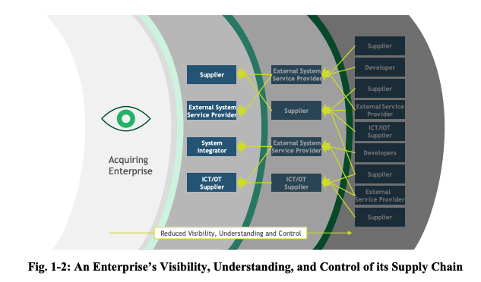
NIST SCRMF 800-161
Notes:
Boyens, Jon, Angela Smith, Nadya Bartol, Kris Winkler, Alex Holbrook, and Matthew Fallon. “Cybersecurity Supply Chain Risk Management Practices for Systems and Organizations.” National Institute of Standards and Technology, October 27, 2021. https://doi.org/10.6028/NIST.SP.800-161r1-draft2.
Frame risk. Establish the context for risk-based decisions and the current state of the
enterprise’s information and communications technology and services and the associated
supply chain.
• Assess risk. Review and interpret criticality, threat, vulnerability, likelihood, impact, and related information.
• Respond to risk. Select, tailor, and implement mitigation controls based on risk
assessment findings.
• Monitor risk. Monitor risk exposure and the effectiveness of mitigating risk on an ongoing basis, including tracking changes to an information system or supply chain using effective enterprise communications and a feedback loop for continuous improvement.

Slide 25
SCRMF 800-161
Frame risk
Establish the context for risk-based decisions and the current state of the enterprise’s information and communications technology and services and the associated supply chain.
Assess risk
Review and interpret criticality, threat, vulnerability, likelihood, impact, and related information.
Respond to risk
Select, tailor, and implement mitigation controls based on risk assessment findings.
Monitor risk
Monitor risk exposure and the effectiveness of mitigating risk on an ongoing basis, including tracking changes to an information system or supply chain using effective enterprise communications and a feedback loop for continuous improvement.
Notes:
Boyens, Jon, Angela Smith, Nadya Bartol, Kris Winkler, Alex Holbrook, and Matthew Fallon. “Cybersecurity Supply Chain Risk Management Practices for Systems and Organizations.” National Institute of Standards and Technology, October 27, 2021. https://doi.org/10.6028/NIST.SP.800-161r1-draft2.
Frame risk. Establish the context for risk-based decisions and the current state of the
enterprise’s information and communications technology and services and the associated
supply chain.
• Assess risk. Review and interpret criticality, threat, vulnerability, likelihood, impact, and related information.
• Respond to risk. Select, tailor, and implement mitigation controls based on risk
assessment findings.
• Monitor risk. Monitor risk exposure and the effectiveness of mitigating risk on an ongoing basis, including tracking changes to an information system or supply chain using effective enterprise communications and a feedback loop for continuous improvement.

Slide 26
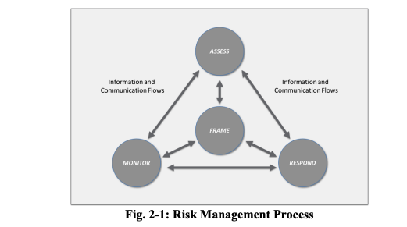
NIST SCRMF 800-161
Notes:
Boyens, Jon, Angela Smith, Nadya Bartol, Kris Winkler, Alex Holbrook, and Matthew Fallon. “Cybersecurity Supply Chain Risk Management Practices for Systems and Organizations.” National Institute of Standards and Technology, October 27, 2021. https://doi.org/10.6028/NIST.SP.800-161r1-draft2.
Frame risk. Establish the context for risk-based decisions and the current state of the
enterprise’s information and communications technology and services and the associated
supply chain.
• Assess risk. Review and interpret criticality, threat, vulnerability, likelihood, impact, and related information.
• Respond to risk. Select, tailor, and implement mitigation controls based on risk
assessment findings.
• Monitor risk. Monitor risk exposure and the effectiveness of mitigating risk on an ongoing basis, including tracking changes to an information system or supply chain using effective enterprise communications and a feedback loop for continuous improvement.

Slide 27
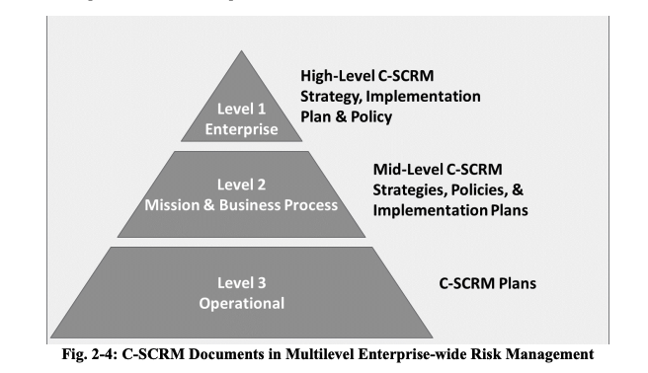
NIST SCRMF 800-161
Notes:
Boyens, Jon, Angela Smith, Nadya Bartol, Kris Winkler, Alex Holbrook, and Matthew Fallon. “Cybersecurity Supply Chain Risk Management Practices for Systems and Organizations.” National Institute of Standards and Technology, October 27, 2021. https://doi.org/10.6028/NIST.SP.800-161r1-draft2.

Slide 28
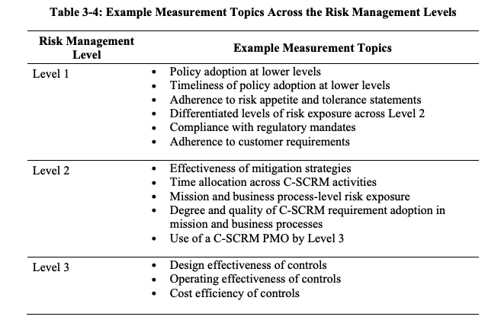
Notes:
Boyens, Jon, Angela Smith, Nadya Bartol, Kris Winkler, Alex Holbrook, and Matthew Fallon. “Cybersecurity Supply Chain Risk Management Practices for Systems and Organizations.” National Institute of Standards and Technology, October 27, 2021. https://doi.org/10.6028/NIST.SP.800-161r1-draft2.

Slide 29
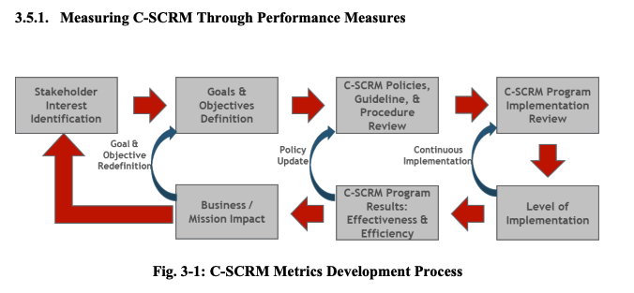
NIST SCRMF 800-161
Notes:
Boyens, Jon, Angela Smith, Nadya Bartol, Kris Winkler, Alex Holbrook, and Matthew Fallon. “Cybersecurity Supply Chain Risk Management Practices for Systems and Organizations.” National Institute of Standards and Technology, October 27, 2021. https://doi.org/10.6028/NIST.SP.800-161r1-draft2.

Slide 30
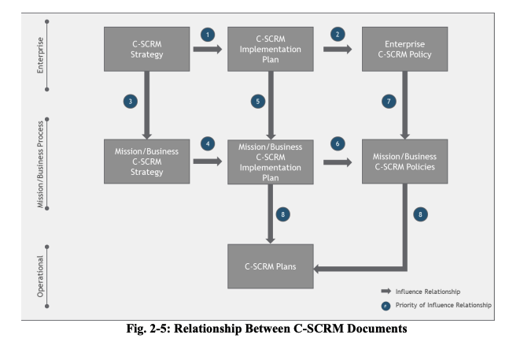
Notes:
Boyens, Jon, Angela Smith, Nadya Bartol, Kris Winkler, Alex Holbrook, and Matthew Fallon. “Cybersecurity Supply Chain Risk Management Practices for Systems and Organizations.” National Institute of Standards and Technology, October 27, 2021. https://doi.org/10.6028/NIST.SP.800-161r1-draft2.

Slide 31
SCRMF 800-161 and NIST 800-53
Section 4 Enhanced Controls
If a [NIST SP 800-53, Rev. 5] control or enhancement was determined to be an information security control that serves as a foundational control for C-SCRM but is not specific to C-SCRM, it is not included in this publication.
If a [NIST SP 800-53, Rev. 5] control or enhancement was determined to be relevant to C-SCRM, the levels in which the control applies are also provided.
If a [NIST SP 800-53, Rev. 5] enhancement was determined to be relevant to C-SCRM but the parent control was not, then the parent control number and title are included, but there is no supplemental C-SCRM guidance.
If [NIST SP 800-53, Rev. 5] already captures withdrawals or reorganization of prior [NIST SP 800-161] controls, it is not included.
Notes:
Boyens, Jon, Angela Smith, Nadya Bartol, Kris Winkler, Alex Holbrook, and Matthew Fallon. “Cybersecurity Supply Chain Risk Management Practices for Systems and Organizations.” National Institute of Standards and Technology, October 27, 2021. https://doi.org/10.6028/NIST.SP.800-161r1-draft2.
The remainder of Section 4 provides the enhanced C-SCRM overlay of NIST SP 800-53, Rev. 5. This section displays the relationship between NIST SP 800-53, Rev. 5 controls and C-SCRM controls in one of the following ways: • If a [NIST SP 800-53, Rev. 5] control or enhancement was determined to be an information security control that serves as a foundational control for C-SCRM but is not specific to C-SCRM, it is not included in this publication. • If a [NIST SP 800-53, Rev. 5] control or enhancement was determined to be relevant to C-SCRM, the levels in which the control applies are also provided. • If a [NIST SP 800-53, Rev. 5] enhancement was determined to be relevant to C-SCRM but the parent control was not, then the parent control number and title are included, but there is no supplemental C-SCRM guidance. • C-SCRM controls/enhancements that do not have an associated [NIST SP 800-53, Rev. 5] control/enhancement are listed with their titles and the control/enhancement text. • All C-SCRM controls include the levels for which the control applies and supplemental C-SCRM guidance as applicable. • When a control enhancement provides a mechanism for implementing the C-SCRM control, the control enhancement is listed within the Supplemental C-SCRM Guidance and is not included separately. • If [NIST SP 800-53, Rev. 5] already captures withdrawals or reorganization of prior [NIST SP 800-161] controls, it is not included. The following new controls and control enhancement have been added: • The C-SCRM Control MA-8 – Maintenance Monitoring and Information Sharing is added to the Maintenance control family • The C-SCRM Control SR-13 – Supplier Inventory is added to the Supply Chain Risk Management control family

Slide 32
SCRMF 800-161 and NIST 800-53
Section 4 Enhanced Controls (Cont)
C-SCRM controls/enhancements that do not have an associated [NIST SP 800-53, Rev. 5] control/enhancement are listed with their titles and the control/enhancement text.
All C-SCRM controls include the levels for which the control applies and supplemental C-SCRM guidance as applicable.
When a control enhancement provides a mechanism for implementing the C-SCRM control, the control enhancement is listed within the Supplemental C-SCRM Guidance and is not included separately.
Notes:
Boyens, Jon, Angela Smith, Nadya Bartol, Kris Winkler, Alex Holbrook, and Matthew Fallon. “Cybersecurity Supply Chain Risk Management Practices for Systems and Organizations.” National Institute of Standards and Technology, October 27, 2021. https://doi.org/10.6028/NIST.SP.800-161r1-draft2.
The remainder of Section 4 provides the enhanced C-SCRM overlay of NIST SP 800-53, Rev. 5. This section displays the relationship between NIST SP 800-53, Rev. 5 controls and C-SCRM controls in one of the following ways: • If a [NIST SP 800-53, Rev. 5] control or enhancement was determined to be an information security control that serves as a foundational control for C-SCRM but is not specific to C-SCRM, it is not included in this publication. • If a [NIST SP 800-53, Rev. 5] control or enhancement was determined to be relevant to C-SCRM, the levels in which the control applies are also provided. • If a [NIST SP 800-53, Rev. 5] enhancement was determined to be relevant to C-SCRM but the parent control was not, then the parent control number and title are included, but there is no supplemental C-SCRM guidance. • C-SCRM controls/enhancements that do not have an associated [NIST SP 800-53, Rev. 5] control/enhancement are listed with their titles and the control/enhancement text. • All C-SCRM controls include the levels for which the control applies and supplemental C-SCRM guidance as applicable. • When a control enhancement provides a mechanism for implementing the C-SCRM control, the control enhancement is listed within the Supplemental C-SCRM Guidance and is not included separately. • If [NIST SP 800-53, Rev. 5] already captures withdrawals or reorganization of prior [NIST SP 800-161] controls, it is not included. The following new controls and control enhancement have been added: • The C-SCRM Control MA-8 – Maintenance Monitoring and Information Sharing is added to the Maintenance control family • The C-SCRM Control SR-13 – Supplier Inventory is added to the Supply Chain Risk Management control family

Slide 33
SCRMF 800-161 and NIST 800-53
Section 4 New Controls
The C-SCRM Control MA-8 – Maintenance Monitoring and Information Sharing is added to the Maintenance control family
The C-SCRM Control SR-13 – Supplier Inventory is added to the Supply Chain Risk Management control family
Notes:
Boyens, Jon, Angela Smith, Nadya Bartol, Kris Winkler, Alex Holbrook, and Matthew Fallon. “Cybersecurity Supply Chain Risk Management Practices for Systems and Organizations.” National Institute of Standards and Technology, October 27, 2021. https://doi.org/10.6028/NIST.SP.800-161r1-draft2.
The remainder of Section 4 provides the enhanced C-SCRM overlay of NIST SP 800-53, Rev. 5. This section displays the relationship between NIST SP 800-53, Rev. 5 controls and C-SCRM controls in one of the following ways: • If a [NIST SP 800-53, Rev. 5] control or enhancement was determined to be an information security control that serves as a foundational control for C-SCRM but is not specific to C-SCRM, it is not included in this publication. • If a [NIST SP 800-53, Rev. 5] control or enhancement was determined to be relevant to C-SCRM, the levels in which the control applies are also provided. • If a [NIST SP 800-53, Rev. 5] enhancement was determined to be relevant to C-SCRM but the parent control was not, then the parent control number and title are included, but there is no supplemental C-SCRM guidance. • C-SCRM controls/enhancements that do not have an associated [NIST SP 800-53, Rev. 5] control/enhancement are listed with their titles and the control/enhancement text. • All C-SCRM controls include the levels for which the control applies and supplemental C-SCRM guidance as applicable. • When a control enhancement provides a mechanism for implementing the C-SCRM control, the control enhancement is listed within the Supplemental C-SCRM Guidance and is not included separately. • If [NIST SP 800-53, Rev. 5] already captures withdrawals or reorganization of prior [NIST SP 800-161] controls, it is not included. The following new controls and control enhancement have been added: • The C-SCRM Control MA-8 – Maintenance Monitoring and Information Sharing is added to the Maintenance control family • The C-SCRM Control SR-13 – Supplier Inventory is added to the Supply Chain Risk Management control family

Slide 34
Exploring NIST 800-161
Review Some Specific Controls
Review “Table B-1: C-SCRM Control Summary”
Notes:
Boyens, Jon, Angela Smith, Nadya Bartol, Kris Winkler, Alex Holbrook, and Matthew Fallon. “Cybersecurity Supply Chain Risk Management Practices for Systems and Organizations.” National Institute of Standards and Technology, October 27, 2021. https://doi.org/10.6028/NIST.SP.800-161r1-draft2.

